Slide 1
Speech on workplace stress
How to cope with it

Slide 2
Introduction
The main focus of this speech is to recognize the causes and solutions for stress within the workplace.
The main sources of workplace stress can range from low salaries, lack of social and team support, excessive workloads and conflicting demands to perform.
Some people usually compound the problem by over eating, consumption of unhealthy foods and even engaging in activities such as smoking (Cooper, Cary L, and Susan Cartwright 71)

Slide 3
Management of stress
There are several steps that can be taken to ensure that workplace stress has been managed. The first step is to track down the stressors.
The second step includes developing healthy responses to the stress.
Establishing work and life boundaries and balances can also create an essential step in the management of workplace stress (Hicks, Trevor, and Caroline McSherry 120)

Slide 4
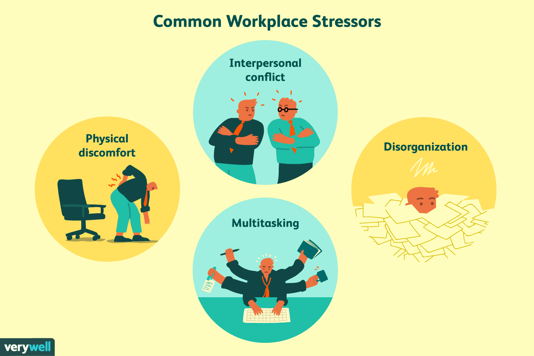
Stressors

Slide 5
Conclusion
To sum it up, most interventions to reduce workplace stress can involve both organizational and individual approaches.
The individual approaches can include counseling of the individuals to identify their stressors and solutions to those problems.
Ensuring employees are relaxed and also providing efficient analysis of the interventions can also be an opportunity to reduce workplace stress and manage any stressful factors in the workplace (Dievernich, Frank, Kim Oliver, and Jie 98)

Slide 6
stress
It is crucial to understand the nature of stress in work and its outcome before we can decrease or mild stress.
Most interventions to decrease the risk to well-being related through stress within the workplace require together personal and organizational advances.
These approaches that can be employed include education, staffing levels, work schedules, personal surroundings, social support, power over employment, involvement, communication as well as one-to-one psychology services-clinical, health or else counseling (Hambler 417)

Slide 7
Workplace mental state treatments focused on people may be focused on moreover management otherwise psychological health endorsement such as cognitive-behavioral approach aiming stress decrease.
Organizational-level work treatments may comprise policies that address prevention as well as premature intervention.
There is various proof that the incorporated approach to workplace mental state, regarding injury prevention through reducing workplace hazards, psychological health promotion, along with management of being sickness, allows the mainly comprehensive management of the mental health requirements.

Slide 8
Counseling is when we get together to solve a specific issue. Everybody in this group helps to determine the reasons.
Some of the job choices for people with a degree in counseling or management include business counselor, mental state counselor or education counselor.
These careers will involve helping people recognize issues in their lives and take ways to improve their quality of life through good choices, or leading students as they take business choices (Pascoe, Ashleigh, Lauren, and Naomi 82)

Slide 9
References
Cooper, Cary L, and Susan Cartwright. Managing Workplace Stress. London: SAGE, 2017. Print.
Dievernich, Frank EP, Kim Oliver Tokarski, and Jie Gong. Change Management and the Human Factor. Springer International Pu, 2016.
Hambler, Andrew. "Managing workplace religious expression within the legal constraints." Employee Relations 38.3 (2016): 406-419.
Hicks, Trevor, and Caroline McSherry. A Guide to Managing Workplace Stress. Boca Raton, Fla: Universal Publishers, 2016. Print.
Pascoe, Ashleigh, Lauren Breen, and Naomi Cocks. "Being prepared for working in palliative care: The speech pathology perspective." Journal of Clinical Practice in Speech-Language Pathology 17.2 (2015): 82-84.

